Slide 1
React
Request - Response Cycle
Mahhek Tahir
Notes:
.

Slide 2
What is Request-Response
In web development, the request-response cycle is the process where a client (browser) requests data from a server, and the server responds with that data.
Request: The React component asks for data.
Processing: The data is retrieved and possibly transformed.
Response: The data is displayed in the UI.

Slide 3
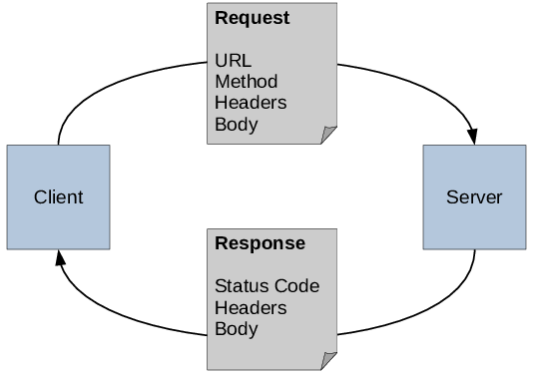
The Cycle

Slide 4
Request
A request is sent from the client (browser) to the server to retrieve or send data.
It consists of:
URL (Endpoint to communicate with the server).
Method (GET, POST, PUT, DELETE, etc.).
Headers (Metadata like Content-Type, Authorization).
Body (Optional, contains data for methods like POST/PUT).
Default method is GET if not specified.
Example requests: Fetching data, submitting a form, updating a record.

Slide 5
Header Example
GET /api/users HTTP/1.1
Host: example.com
Authorization: Bearer <token>
Content-Type: application/json
Accept: application/json
User-Agent: Mozilla/5.0
Authorization → Used for authentication (e.g., JWT token).
Content-Type → Specifies the format of the request body (JSON, XML, etc.).
Accept → Indicates the response format expected by the client.
User-Agent → Identifies the client making the request (browser, app, etc.).

Slide 6
Response
The server's reply to a request, containing data or status.
It consists of:
Status Code (200 OK, 404 Not Found, 500 Server Error, etc.).
Headers (Metadata like Content-Type, Cache-Control).
Body (Actual data, usually in JSON format).
Can be successful (200 OK) or failed (400/500 errors).
Responses should be handled properly to check for errors and extract data.

Slide 7
Header Example
HTTP/1.1 200 OK
Content-Type: application/json
Cache-Control: no-cache
Server: nginx
Set-Cookie: sessionId=abc123; HttpOnly
Content-Type → Specifies the format of the response (JSON, HTML, etc.).
Cache-Control → Determines caching behavior (no-cache, max-age=3600, etc.).
Server → Identifies the server technology (nginx, Apache, etc.).
Set-Cookie → Sends cookies to the client for session management.

Slide 8
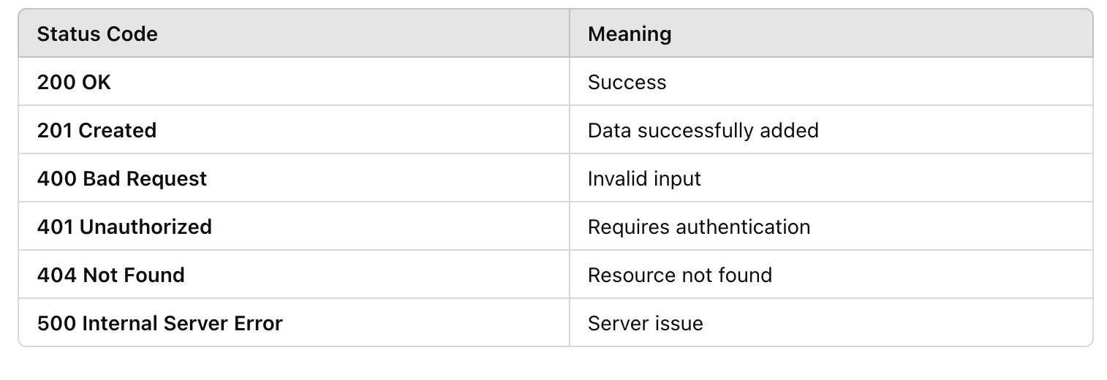
Status Codes

Slide 9
Example - Commenting system - send data
The user enters a comment in the textarea.
On clicking Submit, handleSubmit sends the comment data to an API endpoint.
Displays success or error message based on the response.
Disables the button while submitting to prevent multiple requests.

Slide 10
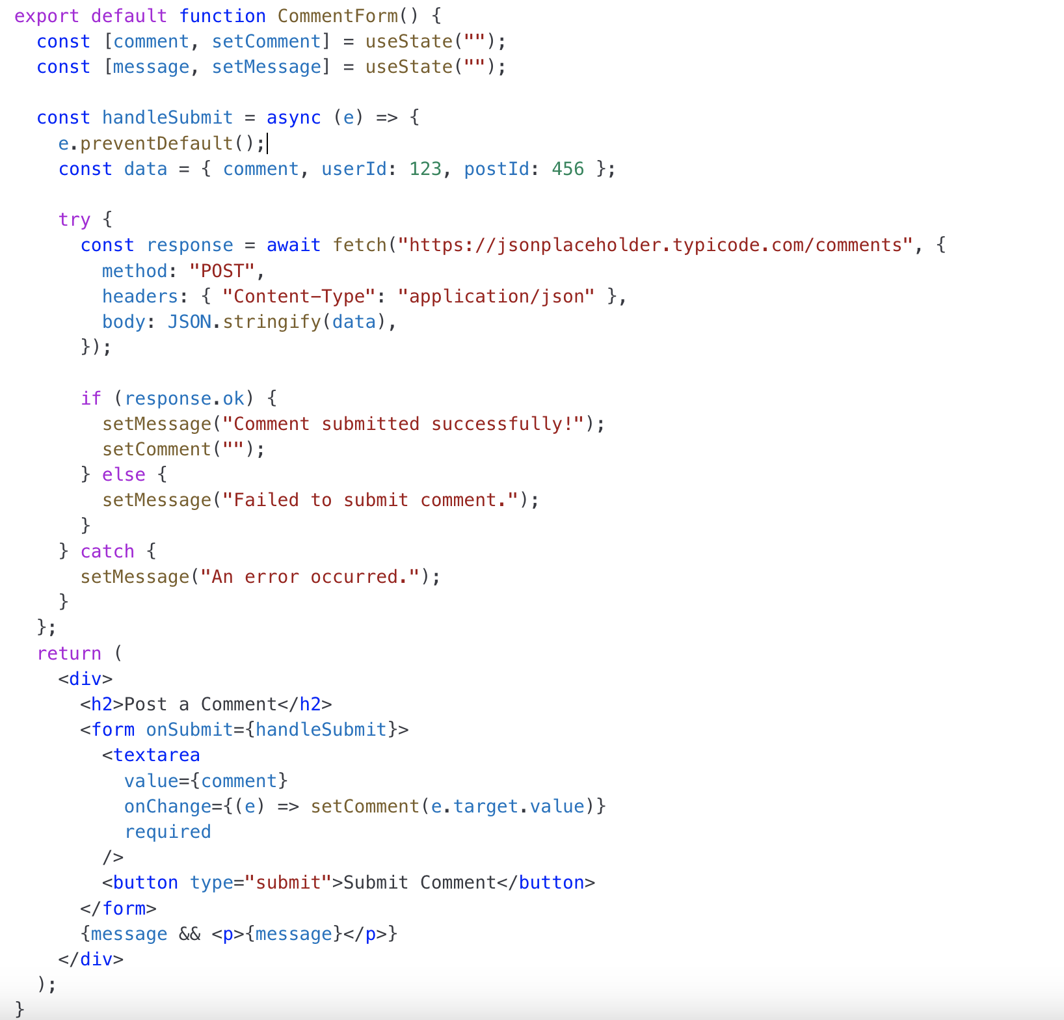

Slide 11
Display Comment - retrieve data
Uses useEffect to fetch comments when the component loads.
Stores the comments in the comments state.
Displays a list of fetched comments.
Limits the fetch to 5 comments for simplicity.
If a method is not specified, the request defaults to a GET request in fetch().

Slide 12
